Slide 1

SUBMITTED BY: Bodkhe Gaurav Abasaheb (2124UCEM1041)
A PROJECT REPORT
ON
“HOTEL MANAGEMENT SYSTEM”
SUBJECT:
PROGRAMMING AND PROBLEM SOLVING USING C++
Under the guidance of
Miss. ISHWARI TIRSE

Slide 2
Hotel Management System

Slide 3
INDEX
Sr. No. | CONTENT | Slide No.
1. | Introduction | 4
2. | Use | 5
3. | Expected Outcomes | 6
4. | Output | 7
5. | Conclusion | 10

Slide 4
INTRODUCTION
A hotel management system is a crucial tool for managing the day-to-day operations of a hotel. Our system, built using C++, will provide a comprehensive solution for managing room bookings, guest information, staff scheduling, and financial transactions. C++ offers a high level of performance, reliability, and flexibility, making it an ideal choice for building a robust and scalable system.
We will utilize C++ concepts such as classes and objects, inheritance and polymorphism, file input/output, data structures, and algorithms to build the system. The system will be designed to be user-friendly and intuitive, with a focus on streamlining hotel operations and improving customer satisfaction.

Slide 5
USE
For User Authentication: Login and logout functionality for admin and users.
For Room Management: Adding, editing, and deleting room details, including room type, capacity, and availability.
For Booking Management: Booking, canceling, and modifying room bookings, including payment processing.
For Guest Management: Storing and managing guest information, including personal details and booking history.
6. For Services Management: Managing hotel services, such as room service, laundry, and amenities.
7. For Reporting: Generating reports on room occupancy, bookings, and revenue.

Slide 6
EXPECTED OUTCOMES
Efficient room management and booking processes
Improved guest experience through personalized services
Optimized service provision and automated Booking processing
Reliable user authentication and data security
Increased productivity and reduced administrative burdens
Reliable user funtions and access controls

Slide 7
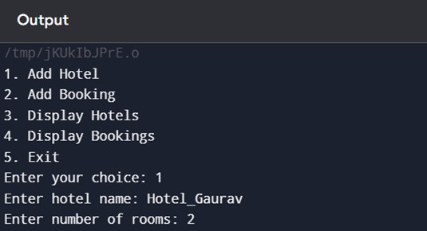
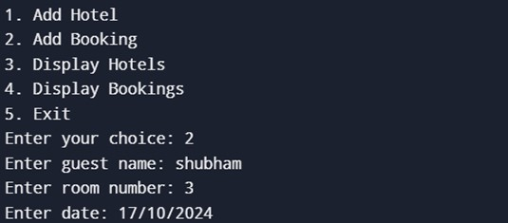
OUTPUT

Slide 8
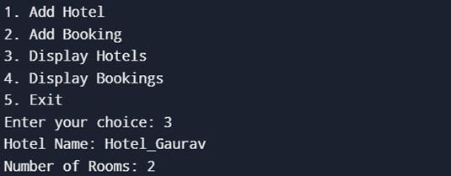
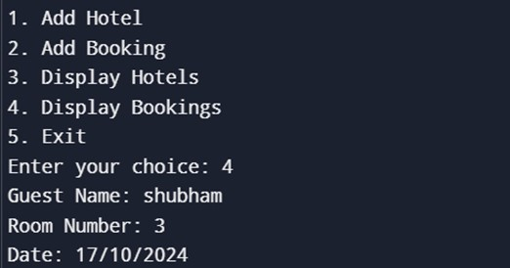

Slide 9
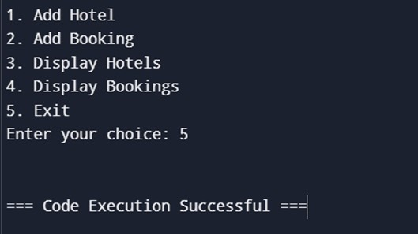

Slide 10
CONCLUSION
The Hotel Management System using C++ is a comprehensive solution that streamlines hotel operations, enhancing efficiency, productivity, and customer satisfaction. It automates room booking, allocation, and deallocation processes, improves guest experience through personalized services, optimizes service provision, and reduces operational costs. The system ensures reliable user authentication and data security and generates comprehensive reports for informed decision-making.
The Hotel Management System using C++ is a cutting-edge solution that transforms hotel operations, driving growth and excellence in the Management industry. Its comprehensive features, scalability, and integration capabilities make it an ideal choice for hotels seeking to enhance their operational efficiency and customer satisfaction.

